Slide 1
Introduction to Logistic Regression
By:Vandana Kate

Slide 3
Logistic regression
Logistic regression is a classification algorithm used to assign observations to a discrete set of classes.
Some of the examples of classification problems are-
Email spam or not spam,
Online transactions Fraud or not Fraud,
Tumor Malignant or Benign.
It is a predictive analysis algorithm and based on the concept of probability
Logistic regression transforms its output using the logistic sigmoid function to return a probability value.

Slide 4
What are the types of logistic regression
Binary (eg. Tumor Malignant or Benign)
Multi-linear functions Class (eg. Cats, dogs or Sheep's)

Slide 5
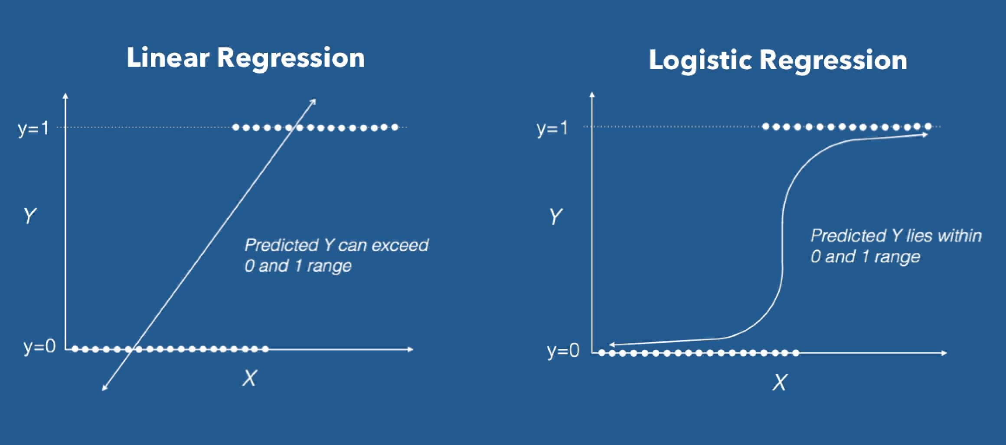

Slide 6
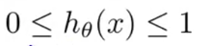
How to restrict value between 0 and 1
Logistic Regression uses activation function called as the ‘Sigmoid function’ or also known as the ‘logistic function’ instead of a linear function.
The hypothesis of logistic regression tends it to limit the cost function between 0 and 1.
Logistic regression hypothesis expectation

Slide 7
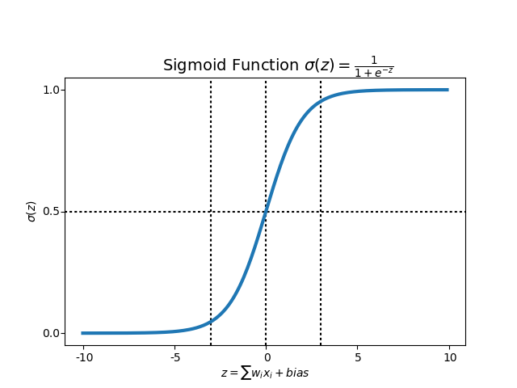
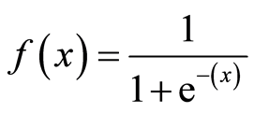
What is the Sigmoid Function?
In order to map predicted values to probabilities, we use the Sigmoid function. The function maps any real value into another value between 0 and 1.
In machine learning, we use sigmoid to map predictions to probabilities.

Slide 8
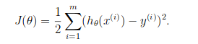
Cost Function
We learnt about the cost function J(θ) in the Linear regression, the cost function represents optimization objective i.e. we create a cost function and minimize it so that we can develop an accurate model with minimum error.
The Cost function of Linear regression

Slide 9
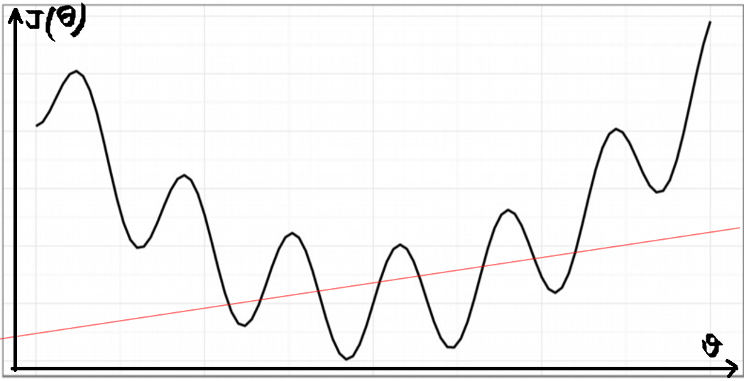
What if we use MSE as Cost Function in Logistic Regression
If we try to use the cost function of the linear regression in ‘Logistic Regression’ then it would be of no use as it would end up being a non-convex function with many local minimums, in which it would be very difficult to minimize the cost value and find the global minimum.

Slide 10
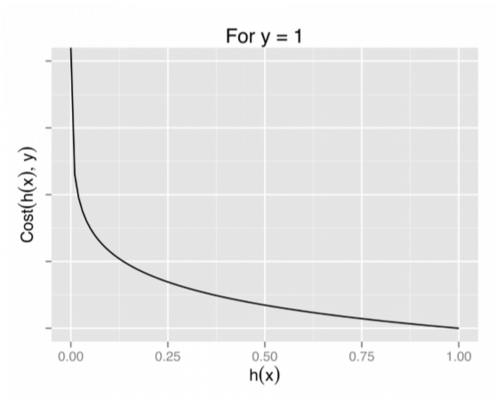
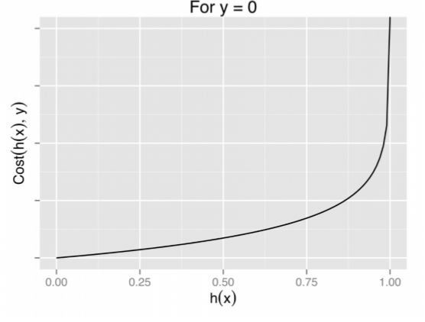
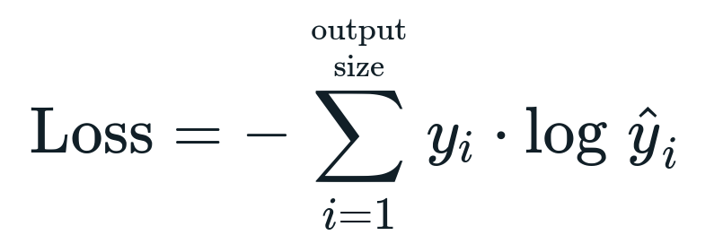

Slide 11
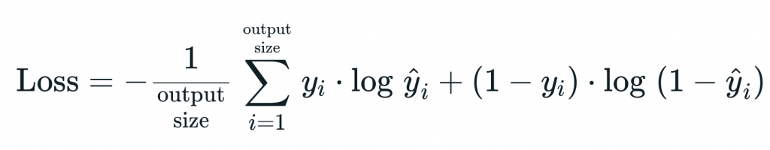
CROSS ENTROPY ERROR

Slide 12
SVM Classifier

Slide 13
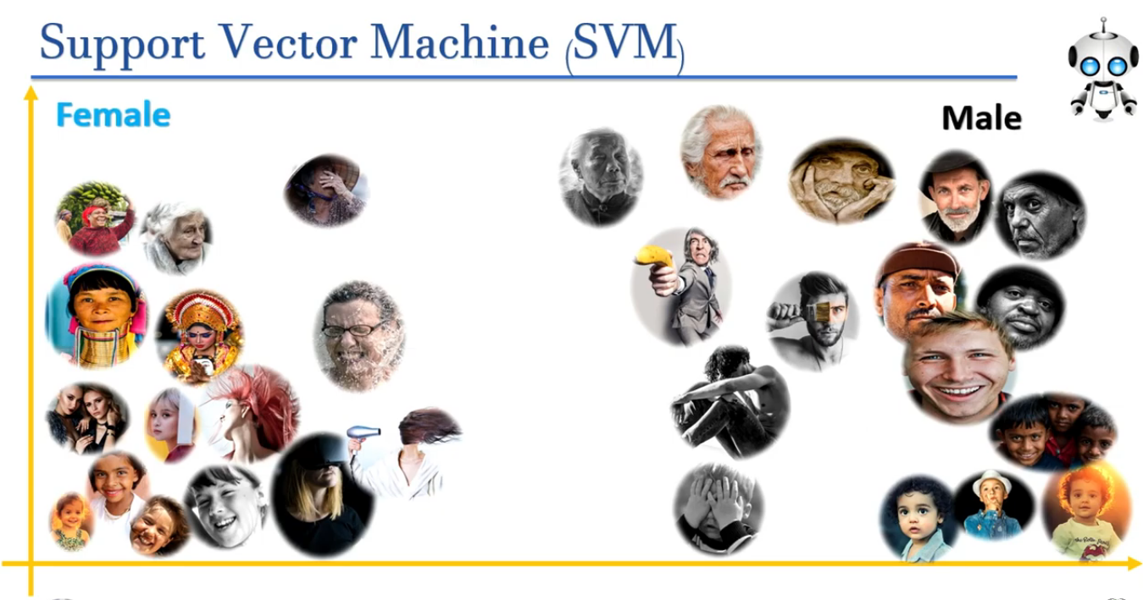

Slide 14
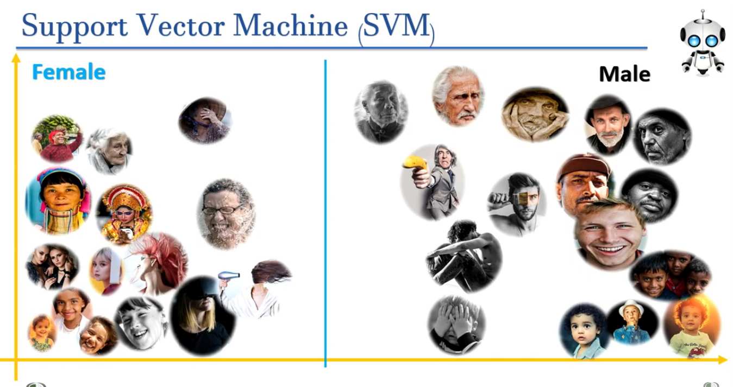

Slide 15
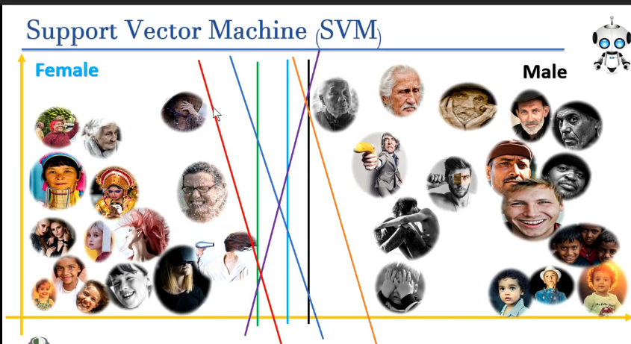

Slide 16
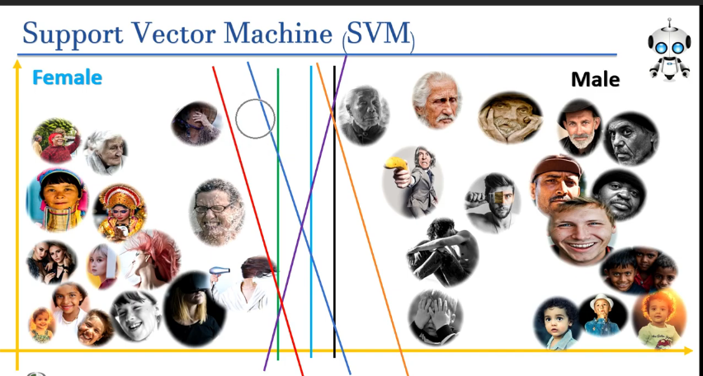

Slide 17
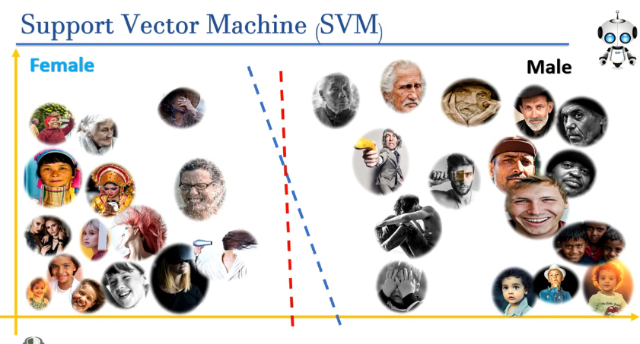

Slide 18
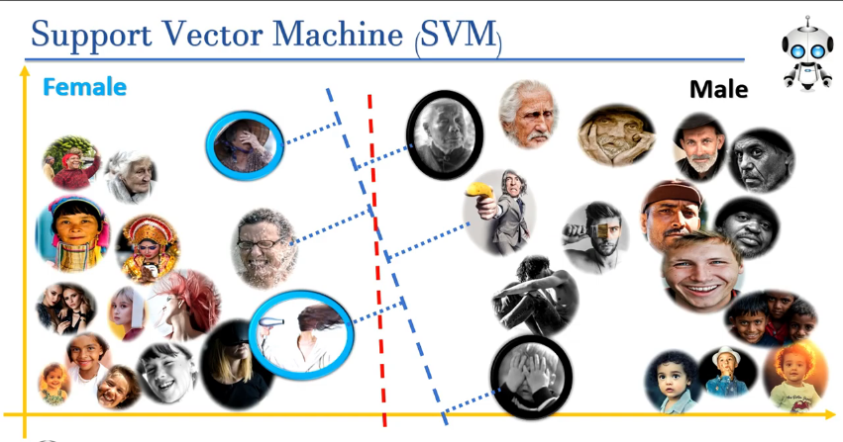

Slide 19
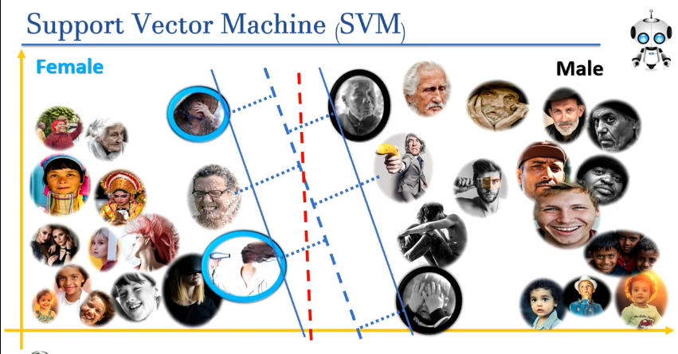

Slide 20
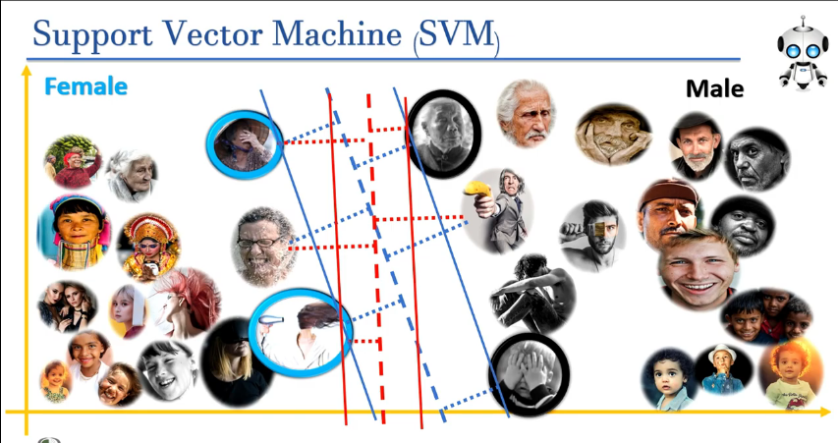

Slide 21
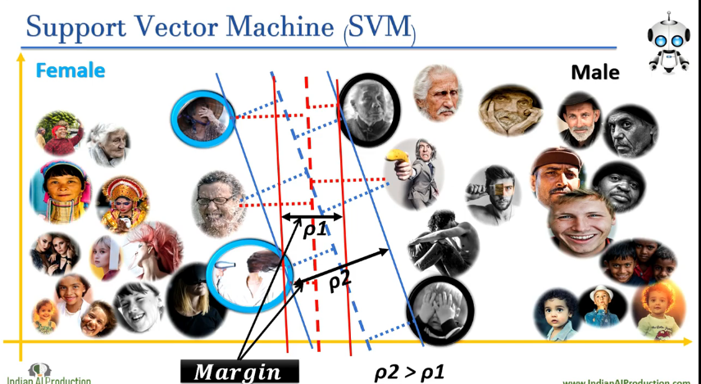

Slide 22
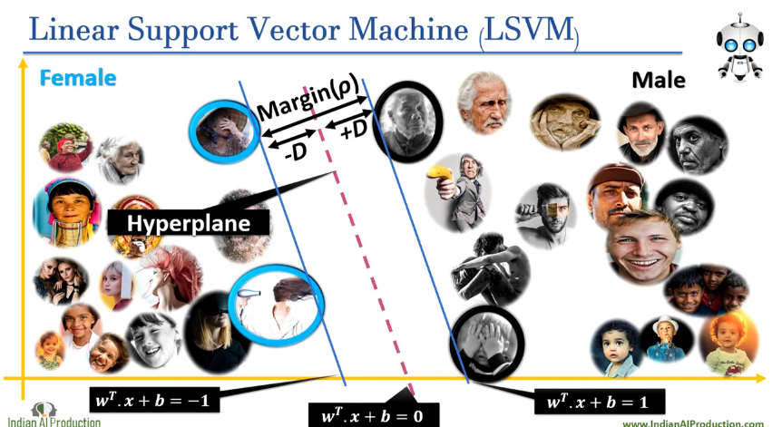

Slide 23
Noisy Data

Slide 24
